Slide 1
Accessible Outdoor Exercise Equipment
At Huron Lodge

Slide 2
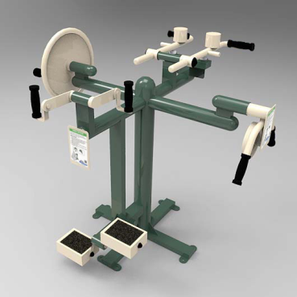
TriActive Accessible MultiGym Modular System

Slide 3
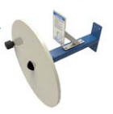
Shoulder Wheel

Slide 4
Shoulder Press

Slide 5
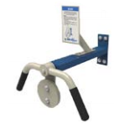
Rotation Station

Slide 6
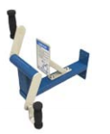
Arm Bike

Slide 7
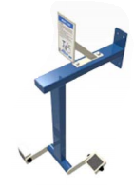
Foot/Leg Bike

Slide 8
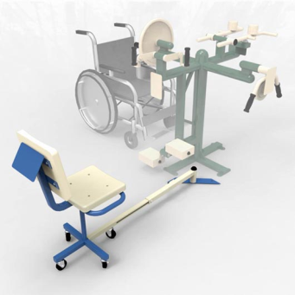
TriActive Accessible MultiGym Modular System with E-Line Swivel Seat

Slide 9
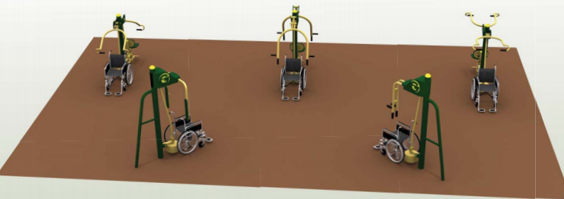
Greenfields Outdoor Fitness Accessible Circuit

Slide 10
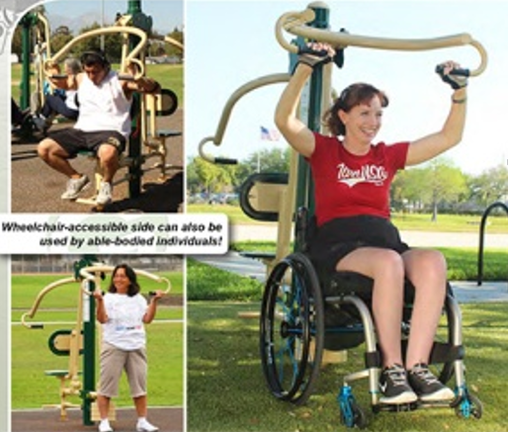
2 Person Accessible Vertical Press

Slide 11
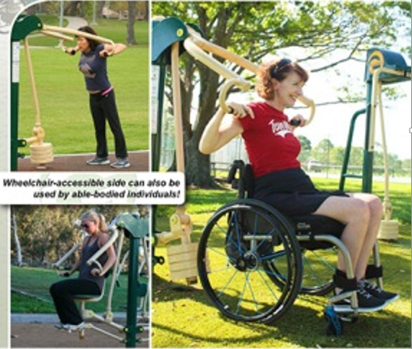
2 person Accessible Lat Pull

Slide 12
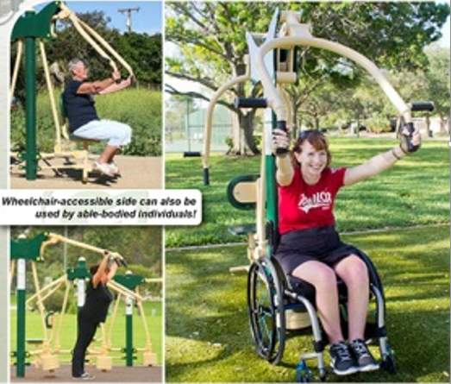
2 person Accessible Chest Press

Slide 13
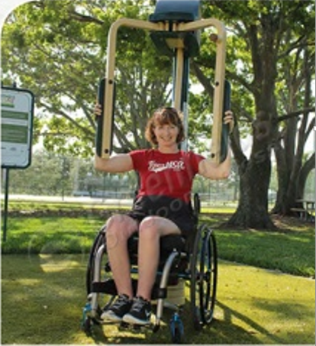
Accessible Single Butterfly

Slide 14
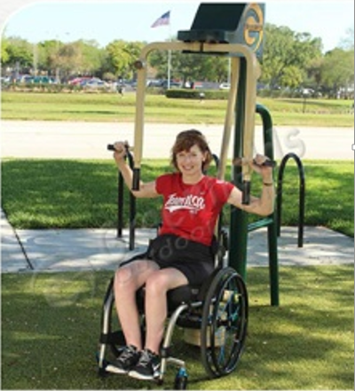
Accessible Reverse Butterfly

