Slide 1
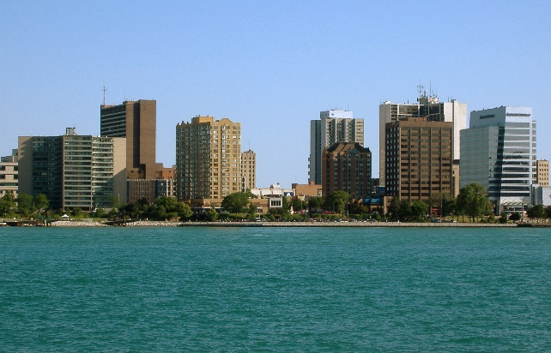
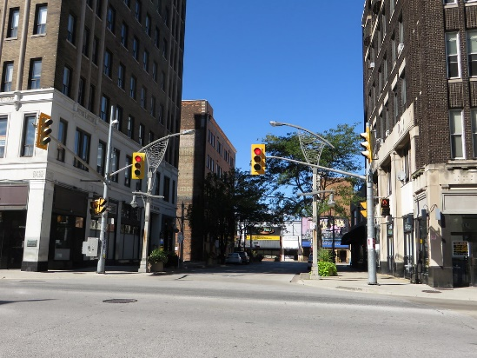
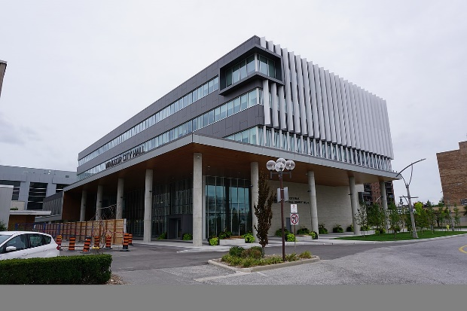


City of Windsor
2020 Development Charges Study
Task Force Meeting #2
Thursday, December 5th, 2019

Slide 2
Today we will discuss...
Update on Study Process and Approach
Preliminary Development Forecast
Draft Capital Programs
  Non-discounted services
Policy Considerations
Next Steps

Slide 3
Study Process
Summer 2019
October 2019
Staff Kick-off Meetings
Finalize Development Forecasts
September 2019
Nov. – Dec. 2019
Jan. – Feb. 2020
Preliminary Service Level Analysis
Individual Department Meetings
Task Force Meeting #1: Project Introduction
Mar. – May
2020
Respond to Written Submissions
Council Passage of DC By-law
Preliminary Development Forecasts
Background Review & Info Requests
Finalize Service Level Analysis
Complete Draft Capital Programs
Task Force Meeting #2: Forecasts & Capital Programs
Task Force Meeting #3: Draft Rates & Policy Recommendations
Council Info Session
Finalize DC Rates
Statutory Public Meeting
TBD (2020)
CBC By-law Passage
Prepare CBC Strategy & By-law
Release DC Background Study & By-law
Preliminary DC Rate Calculation
Sept. 26
Sept. 26-27
Dec. 5

Slide 4
City of Windsor
DC & CBC Services
2020 DC Background Study
Fire
2020 CBC Strategy
General Government
Police
Public Works
Transit
Waste Diversion
Library
Indoor Recreation
Park Development & Acquisition
Parking
Roads & Related
Sewage Treatment
Sanitary Sewer
Storm Sewer & Municipal Drains
Water

Slide 5
Bill 108 & Community Benefits Charges
Final regulations still to be released
  Will determine CBC strategy requirements
Windsor CBC Stategy process on hold until regulations are made available
DC Study process proceeding as planned

Slide 6
Scope of New
Community Benefits Charges
Development Charges for “Discounted Services”
Parkland Dedication and CIL
Section 37/Height & Density Bonusing
Community Benefits Charges
Present (2019)
Current regime under the Development Charges Act and Planning Act
Future (2021)
New regime under the Planning Act

Slide 7
Preliminary Development Forecasts
Forecast of City-wide population, household and employment to 2029
  Forecast based on recent Statistics Canada data, CMHC data, and Hemson analyses
  10-year planning period for all City-wide services
Sandwich South area-specific forecast to 2041
  Covers East Pelton & County Road 42 Secondary Plan areas only
  2020-2041 planning period for area-specific engineered services DCs

Slide 8
City-wide Forecast
 | 2020-2029
 | At 2019 | Growth 2020-2029 | At 2029
Residential
Dwelling Units | 93,840 | 6,380 | 100,220
Census Population | 220,030 | 10,430 | 230,460
Non-Residential
Employment | 109,550 | 2,710 | 112,260
New Non-Res Building Space (sq.m) |  | 194,420

Slide 9
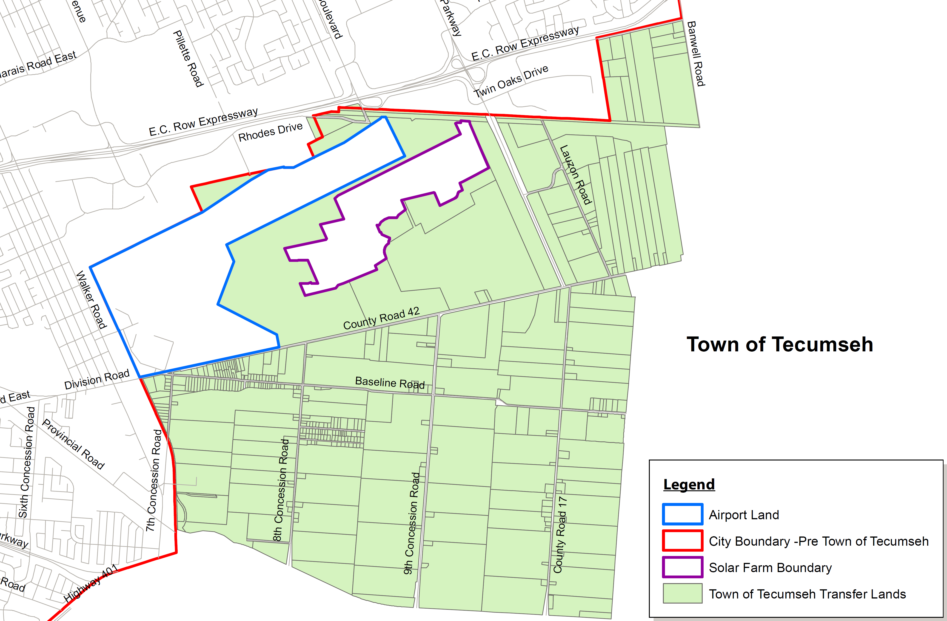
Sandwich South Forecast
Assume growth in Sandwich South to 2041 will occur within East Pelton & County Road 42 Secondary Plan areas
County Road 42
East Pelton

Slide 10
Sandwich South Forecast
 | Growth 2020-2041
Residential
Dwelling Units | 5,000
Population in New Dwellings | 13,300
Non-Residential
Employment | 9,470
New Non-Res Building Space (sq.m) | 767,000

Slide 11
10-Year Historical Service Levels
Maximum allowable charge for general services based on average service level provided in preceding 10 years
Calculated by multiplying 10-year historical average service level by the forecast growth in the 10-year planning period
Establishes a development charges ceiling & will inform allocation of costs

Slide 12
Transit: Ridership-Based Approach
DCA requires Transit DC calculations to be based on a “planned” level of service
Continuing to work on “benefit to existing” & growth cost allocations based on City ridership data and targets
 | Ridership | Rides/Capita
2019 | 8,430,000 | 38.3
2020 | 8,510,000 | 38.5
2021 | 8,780,000 | 39.6
2022 | 9,220,000 | 41.4
2023 | 10,110,000 | 45.3
2024 | 10,570,000 | 47.3
2025 | 11,580,000 | 51.7
2026 | 12,035,205 | 53.6
2027 | 12,508,304 | 55.7
2028 | 13,000,000 | 57.8
2029 | 13,511,000 | 60.0
10-yr Growth | 5,081,000 | 21.7
Source: 2019 Transit Master Plan

Slide 13
General Services
Draft Capital Programs
Capital programs have been developed in consultation with City staff
  Key data sources: draft 8-year capital plan; discussions with Finance and service area staff
DC eligible costs are adjusted in accordance with legislation:
  Grants, subsidies & contributions
  Benefit to existing or replacement elements
  Available DC reserve funds
  “Post-period” benefit shares
    Primarily based on funding envelope restrictions

Slide 14
Fire Services
Total Capital Program | Grants / Subsidies | Benefit-to-Existing / Replacement | Development-Related
$33,159,677 | $177,290 | $20,629,500 | $12,352,887
2020-2029 Draft Capital Program:
  Station #8 & EOC (remaining costs)
  Fire Training Centre
  Station 1 Replacement & Expansion
  Additional Vehicles & Equipment
  Fire Master Plan
Notes:
Draft funding envelope: $3,030,547

Slide 15
Police Services
Total Capital Program | Grants / Subsidies | Benefit-to-Existing / Replacement | Development-Related
$8,020,388 | $0 | $6,093,349 | $1,927,039
2020-2029 Draft Capital Program:
  Collision Reporting Centre Expansion
  Expansion of Patrol Space
  Major Crimes Expansion
  Internet Crime Unit Expansion
  Equipment & Evidence Storage Handling Area Expansion
  Various equipment additions
Notes:
Draft funding envelope: $2,850,973

Slide 16
Public Works
Total Capital Program | Grants / Subsidies | Benefit-to-Existing / Replacement | Development-Related
$1,741,431 | $40,262 | $0 | $1,701,169
2020-2029 Draft Capital Program:
  Purchase of Additional Fleet
Notes:
Draft funding envelope: $2,444,762

Slide 17
Transit
Total Capital Program | Grants / Subsidies | Net Municipal Cost | Benefit-to-Existing | Development-Related
$81,944,769 | $56,428,076 | $25,516,693 | TBD | TBD
2020-2029 Draft Capital Program:
  Smart Bus Technology – Phase 2 (remaining costs)
  35 Additional Buses
  Garage Expansion to accommodate additional buses
  West End Terminal – Phase 2 Expansion
  Bus Stop Investment Program
  Update to Bus Stop P&D Guidelines
  Transit Priority Measures
  Other Transit Master Plan Service Improvements
Significant BTE share will be attributed – under evaluation

Slide 18
Waste Diversion
Total Capital Program | Grants / Subsidies | Benefit-to-Existing / Replacement | Development-Related
$45,210,329 | $0 | $42,962,853 | $2,247,476
2020-2029 Draft Capital Program:
  Organic Waste Processing Facility
  Additional Organic Waste Collection Vehicles
Notes:
Draft funding envelope: $1,035,893

Slide 19
City-wide Engineered Services
Draft Capital Programs
Capital programs have been developed in consultation with City staff
DC eligible costs are adjusted in accordance with legislation:
  Grants, subsidies & contributions
  Benefit to existing or replacement elements
    Largely from previous DC study
  Sandwich South shares
  Available DC reserve funds
  “Post-period” benefit shares
    Largely from previous DC study: 66% of projects occurring in 1-5 yrs; 85% of projects occurring 5-10 yrs; 100% of projects occurring 10+ yrs
    Recognizes long planning and benefitting period

Slide 20
Roads and Related
Total Capital Program | Grants / Subsidies | Benefit-to-Existing / Replacement | Sandwich South Share | City-Wide Development-Related
$1,348,997,947 | $26,512,851 | $485,254,201 | $335,893,375 | $501,337,520
2020-2029 Draft Capital Program:
  Recovery of past roads and related projects
  Planned City-wide roads & related infrastructure projects
    Note: Projects identified as 10+ years are allocated 100% post-period
  City-wide component of Sandwich South projects
  Transportation Master Plan & EA Studies

Slide 21
Sewage Treatment
Total Capital Program | Grants / Subsidies | Benefit-to-Existing / Replacement | Development-Related
$379,163,000 | $53,000,000 | $43,790,000 | $282,373,000
2020-2029 Draft Capital Program:
  Lou Romano Water Redemption Plant upgrade & expansion
  Little River Pollution Control Plant expansion
    100% post-period
  Pumping Station study
Note: uniform charge to apply City-wide, including Sandwich South

Slide 22
Sanitary Sewers
Total Capital Program | Grants / Subsidies | Benefit-to-Existing / Replacement | Sandwich South Share | City-Wide Development-Related
$46,418,803 | $23,456,000 | $2,461,271 | $10,921,250 | $9,580,282
2020-2029 Draft Capital Program:
  City-wide linear infrastructure projects
  City-wide component of Sandwich South projects
    Incl. recovery of past projects not yet fully funded

Slide 23
Storm & Drains
Total Capital Program | Grants / Subsidies | Benefit-to-Existing / Replacement | Sandwich South Share | City-Wide Development-Related
$53,875,035 | $5,427,162 | $19,846,847 | $99,195 | $28,501,831
2020-2029 Draft Capital Program:
  City-wide storm and drain projects
  Recovery of past projects not yet fully funded
  City-wide component of Sandwich South projects (Little River improvements)

Slide 24
Water
Capital program currently under review (ENWIN)
Draft to be circulated to Task Force next week

Slide 25
Sandwich South
Draft Capital Programs
Capital programs have been developed in consultation with City staff
  Generally consistent with 2018 DC amendment study
  Costs adjusted to reflect current dollars
DC eligible costs are adjusted in accordance with legislation:
  Grants, subsidies & contributions
  Benefit to existing or replacement elements
  City-wide shares
  “Post-period” benefit shares
    SSPD outside of East Pelton & County Road 42 (post-2041)

Slide 26
Roads and Related
Total Capital Program | Grants & Other Recoveries | Benefit to Existing | City-wide Shares | Sandwich South Development-Related
$495,360,000 | $0 | $95,556,000 | $59,335,625 | $340,468,375
2020-2041 Draft Capital Program:
  Urbanization of 7th, 8th, & 9th Concession, Baseline Rd., CR17
  New road construction: Collector roads, Lauzon Parkway, CR42, E-W Arterial
  EA studies & Functional Servicing Reports

Slide 27
Sanitary Sewers
Total Capital Program | Grants & Other Recoveries | Benefit to Existing | City-wide Shares | Sandwich South Development-Related
$64,653,644 | $23,456,000 | $0 | $3,451,750 | $37,745,894
2020-2041 Draft Capital Program:
  CR42, CR17, 9th Concession, & Legacy Park Drive sanitary sewer construction
  Recoveries for previously completed SSPD sanitary sewers

Slide 28
Storm Sewer & Municipal Drains
Total Capital Program | Grants & Other Recoveries | Benefit to Existing | City-wide Shares | Sandwich South Development-Related
$224,058,000 | $36,521,440 | $753,950 | $17,505 | $186,765,105
2020-2041 Draft Capital Program:
  Upper Little River SWM Plan & Implementation
  Little River Drain Improvements
  Studies

Slide 29
Water
Total Capital Program | Grants & Other Recoveries | Benefit to Existing | City-wide Shares | Sandwich South Development-Related
$34,465,000 | $0 | $9,781,260 | $0 | $24,683,740
Capital program and all adjustments as per WUC Water Servicing Plan Update 2018 – Sandwich South Planning District Area Development Charges
  Draft report dated April 9, 2018

Slide 30
Policy Directions
Area rating
  Maintain area-specific approach to engineered services rates for Sandwich South
    Uniform general services DCs to apply to all development
Adjust residential unit type definitions to align with zoning by-law
  No change to rate structure proposed
Annual DC index date
  Move from June 1 to November 1
    Less busy time of year

Slide 31
Next Steps
  Finalize development forecasts & capital programs: Dec. 2019
  Calculate draft DCs: Jan. 2020
  Task Force Meeting #3: Late Jan. 2020
  Council Info Session: Feb. 2020
  Preparation & Release of Background Study: Late Feb. / early March 2020
  Statutory Public Meeting: March/April 2020

Slide 32
Hemson Contacts
  Craig Binning, Project Manager
    416-593-5090 ext. 20; cbinning@hemson.com
  Julia Cziraky, Consultant
    416-593-5090 ext. 25; jcziraky@hemson.com
  Courtney King, Consultant
    416-593-5090 ext. 38; cking@hemson.com

